Slide 1
Hadoop File System was developed using distributed file system design. It is run on commodity hardware. Unlike other distributed systems, HDFS is highly faulttolerant and designed using low-cost hardware.
HDFS holds very large amount of data and provides easier access. To store such huge data, the files are stored across multiple machines. These files are stored in redundant fashion to rescue the system from possible data losses in case of failure. HDFS also makes applications available to parallel processing.
Features of HDFS
It is suitable for the distributed storage and processing.
Hadoop provides a command interface to interact with HDFS.
The built-in servers of namenode and datanode help users to easily check the status of cluster.
Streaming access to file system data.
HDFS provides file permissions and authentication.

Slide 2
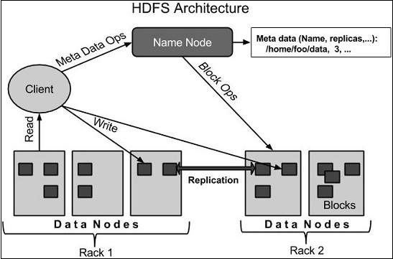
HDFS Architecture
Given below is the architecture of a Hadoop File System

Slide 3
Hadoop File System was developed using distributed file system design. It is run on commodity hardware. Unlike other distributed systems, HDFS is highly faulttolerant and designed using low-cost hardware.
HDFS holds very large amount of data and provides easier access. To store such huge data, the files are stored across multiple machines. These files are stored in redundant fashion to rescue the system from possible data losses in case of failure. HDFS also makes applications available to parallel processing.
Features of HDFS
It is suitable for the distributed storage and processing.
Hadoop provides a command interface to interact with HDFS.
The built-in servers of namenode and datanode help users to easily check the status of cluster.
Streaming access to file system data.
HDFS provides file permissions and authentication.
HDFS Architecture
Given below is the architecture of a Hadoop File System.
HDFS follows the master-slave architecture and it has the following elements.
Namenode
The namenode is the commodity hardware that contains the GNU/Linux operating system and the namenode software. It is a software that can be run on commodity hardware. The system having the namenode acts as the master server and it does the following tasks −
Manages the file system namespace.
Regulates client’s access to files.
It also executes file system operations such as renaming, closing, and opening files and directories.
HDFS follows the master-slave architecture and it has the following elements.
Namenode
The namenode is the commodity hardware that contains the GNU/Linux operating system and the namenode software. It is a software that can be run on commodity hardware.
NameNode stores the filesystem metadata, that is, files names, information about blocks of a file, blocks locations, permissions, etc.
It manages the Datanodes.
The system having the namenode acts as the master server and it does the following tasks −
Manages the file system namespace.
Regulates client’s access to files.
It also executes file system operations such as renaming, closing, and opening files and directories.

Slide 4
Datanode
The datanode is a commodity hardware having the GNU/Linux operating system and datanode software. For every node (Commodity hardware/System) in a cluster, there will be a datanode. These nodes manage the data storage of their system.
DataNodes are the slave nodes that store the actual business data. It serves the client read/write requests based on the NameNode instructions.
DataNodes stores the blocks of the files.
Datanodes perform read-write operations on the file systems, as per client request.
They also perform operations such as block creation, deletion, and replication according to the instructions of the namenode.

Slide 5
Block
Generally the user data is stored in the files of HDFS. The file in a file system will be divided into one or more segments and/or stored in individual data nodes. These file segments are called as blocks.
In other words, the minimum amount of data that HDFS can read or write is called a Block.
The default block size is 64MB, but it can be increased as per the need to change in HDFS configuration.

Slide 6
Goals of HDFS
Fault detection and recovery − Since HDFS includes a large number of commodity hardware, failure of components is frequent. Therefore HDFS should have mechanisms for quick and automatic fault detection and recovery.
Huge datasets − HDFS should have hundreds of nodes per cluster to manage the applications having huge datasets.
Hardware at data − A requested task can be done efficiently, when the computation takes place near the data. Especially where huge datasets are involved, it reduces the network traffic and increases the throughput.

Slide 7
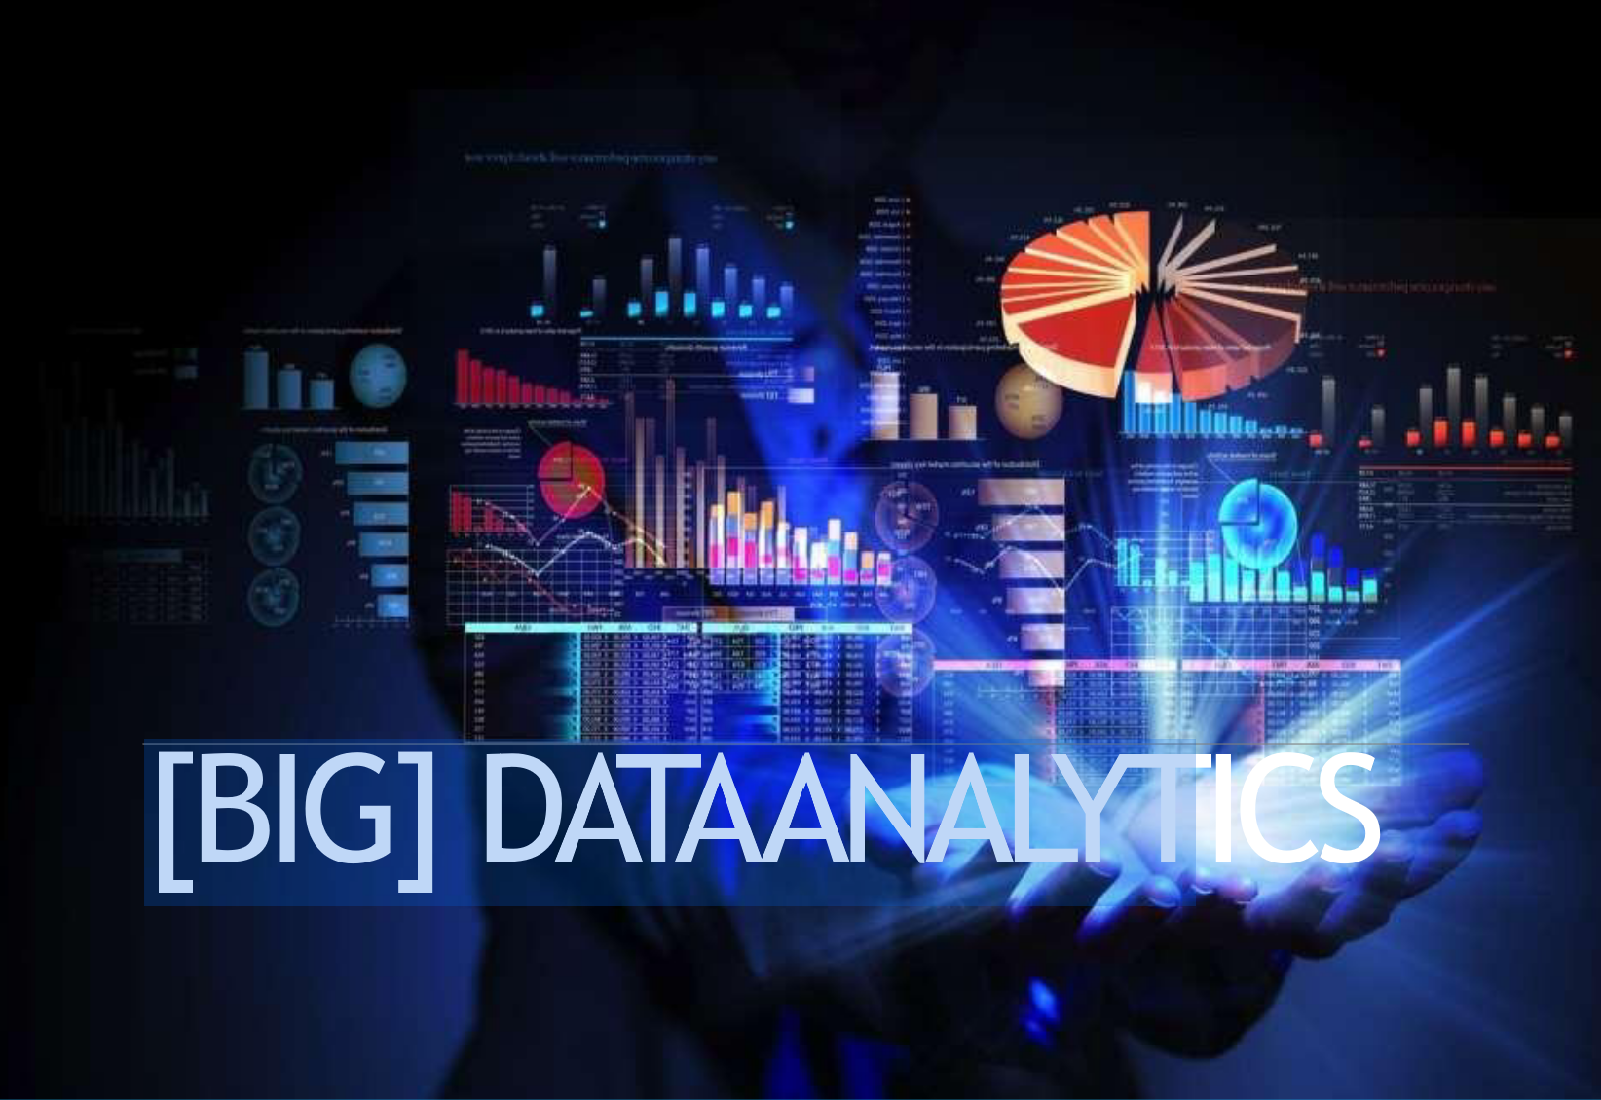

Slide 8
What Is Big Data?
Big data is a massive amount of datasets that cannot be stored, processed and analyzed using traditional tools.
It is defined as : “Big Data are high volume, high velocity, or high-variety information assets that require new forms of processing to enable enhanced decision making, insight discovery, and process optimization.”
The term ‘big data’ is self-explanatory − a collection of huge data sets that normal computing techniques cannot process. The term not only refers to the data, but also to the various frameworks, tools, and techniques involved. Technological advancement and the advent of new channels of communication (like social networking) and new, stronger devices have presented a challenge to industry players in the sense that they have to find other ways to handle the data.
Big data is an open-source software framework for storing data and executing applications on commodity hardware clusters.
Big data refers to large data sets that may be analyzed computationally to reveal patterns, trends, and associations, especially relating to human behavior and interactions

Slide 9
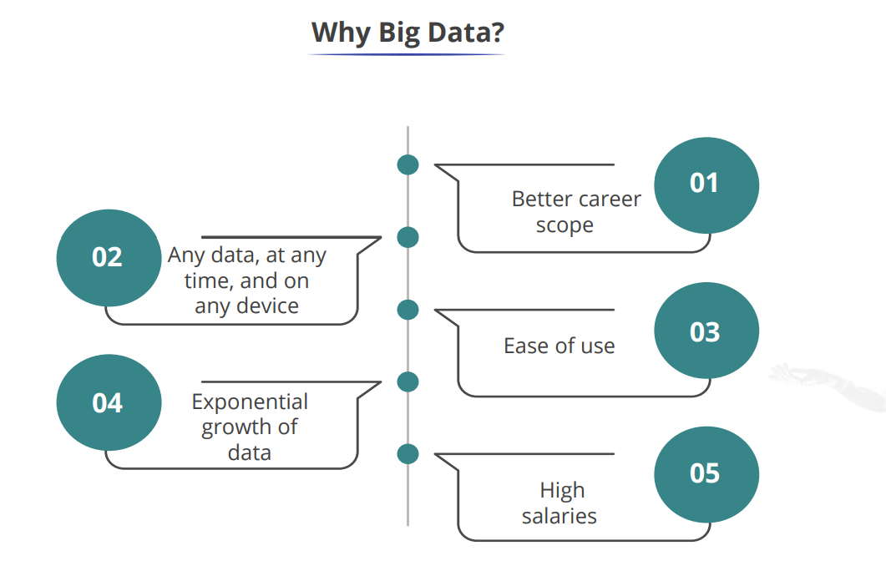

Slide 10
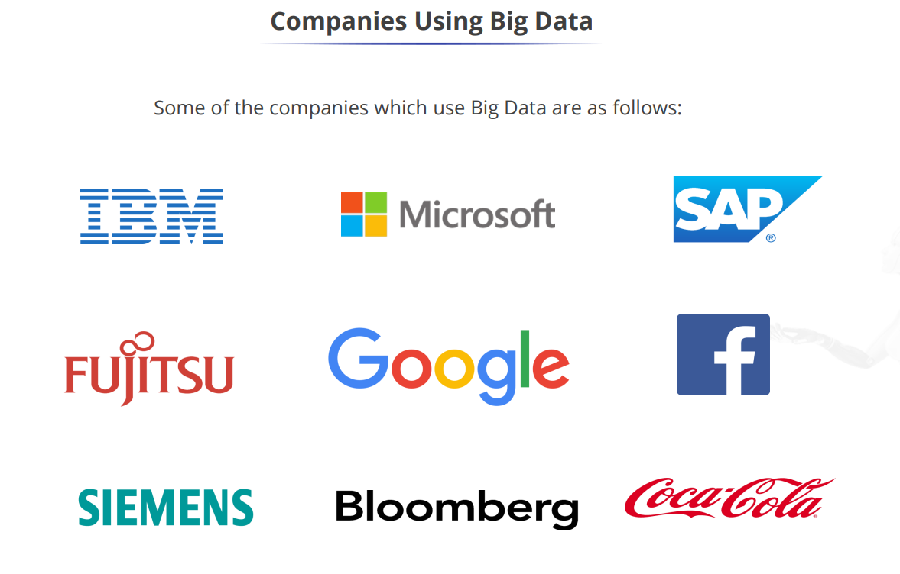

Slide 11
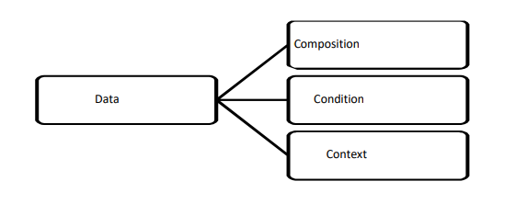
Characteristics of Data:
1.Composition: The composition of data deals with the structure of data, that is, the sources of data, the granularity, the types, and the nature of data as to whether it is static or real-time streaming.
2.Condition: The condition of data deals with the state of data, that is, "Can one use this data as is for analysis?" or "Does it require cleansing for further enhancement and enrichment?“
3.Context: The context of data deals with "Where has this data been generated?" "Why was this data generated?" How sensitive is this data?" "What are the events associated with this data?" and so on. Small data (data as it existed prior to the big data revolution) is about certainty. It is about known data sources; it is about no major changes to the composition or context of data

Slide 12
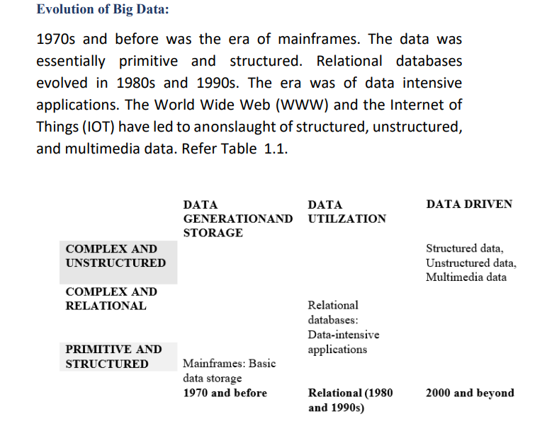

Slide 13
Applications of Big Data
a. Tracking Customer Spending Habit, Shopping Behavior: In big retails store (like Amazon, Walmart, Big Bazar etc.) management team has to keep data of customer’s spending habit, shopping behavior, customer’s most liked product.
Banking sector uses their customer’s spending behavior-related data so that they can provide the offer to a particular customer to buy his particular liked product by using the bank's credit or debit card with discount or cashback.
b. Recommendation:
By tracking customer spending habits, shopping behavior, Big retails stores provide a recommendation to the customer.
E-commerce sites like Amazon, Walmart, and Flipkart do product recommendations.
c. Smart Traffic System:
Data about the condition of the traffic of different roads, collected through cameras kept beside the road, at entry and exit points of the city, GPS devices placed in the vehicle (Ola, Uber cab, etc.).
Notes:
(in which product customer spent, in which brand they wish to spent, how frequently they spent), shopping behavior, customer’s most liked product (so that they can keep those products in the store).

Slide 14
Applications of Big Data
d. Secure Air Traffic System:
At various places of flight (like propellers etc) sensors are present. These sensors capture data like the speed of flight, moisture, temperature, and other environmental conditions. Based on such data analysis, environmental parameters within flight are set up and varied.
By analyzing flight’s machine-generated data, it can be estimated how long the machine can operate flawlessly, when it is to be replaced/repaired.
e. Self Driving Cars:
Big data analysis helps drive a car without human interpretation. In the various spots of the car camera, a sensor is placed that gathers data like the size of the surrounding car, obstacles, distance from those, etc.
These data are being analyzed, then various calculations like how many angles to rotate, what should be speed, when to stop, etc are carried out. These calculations help to take action automatically.
Notes:
(in which product customer spent, in which brand they wish to spent, how frequently they spent), shopping behavior, customer’s most liked product (so that they can keep those products in the store).

Slide 15
Applications of Big Data
f. Virtual Personal Assistant Tool :
Big data analysis helps virtual personal assistant tools like Siri, Cortana and Google Assistant to provide the answer to the various questions asked by users.
This tool tracks the location of the user, their local time, season, other data related to questions asked, etc. Ex: user asks “Do I need to take Umbrella?”
e. Education Sector:
Online educational courses conducting organization utilize big data to search candidates interested in that course.
If someone searches for a YouTube tutorial video on a subject, then an online or offline course provider organization on that subject sends an ad online to that person about their course.
Notes:
(in which product customer spent, in which brand they wish to spent, how frequently they spent), shopping behavior, customer’s most liked product (so that they can keep those products in the store).

Slide 16
Applications of Big Data
f. Media and Entertainment Sector :
Media and entertainment service providing company like Netflix, Amazon Prime, Spotify do analysis on data collected from their users.
Data like what type of video, music users are watching, listening to most, how long users are spending on site, etc are collected and analyzed to set the next business strategy.
g. IoT :
Manufacturing companies install IOT sensors into machines to collect operational data. Analyzing such data, it can be predicted how long a machine will work without any problem when it requires repair.
Thus, the cost to replace the whole machine can be save.
h. Medical diagnosis:
Notes:
(in which product customer spent, in which brand they wish to spent, how frequently they spent), shopping behavior, customer’s most liked product (so that they can keep those products in the store).

Slide 17
Importance of Big Data
a. Cost Savings :
Some tools of Big Data like Hadoop can bring cost advantages to business when large amounts of data are to be stored.
These tools help in identifying more efficient ways of doing business.
b. Time Reductions :
The high speed of tools like Hadoop and in-memory analytics can easily identify new sources of data which helps businesses analyzing data immediately.
o This helps us to make quick decisions based on the learnings.
c. Understand the market conditions : o By analyzing big data we can get a better understanding of current market conditions. o For example: By analyzing customers’ purchasing behaviours, a company can find out the products that are sold the most and produce products according to this trend. By this, it can get ahead of its competitors.
Notes:
(in which product customer spent, in which brand they wish to spent, how frequently they spent), shopping behavior, customer’s most liked product (so that they can keep those products in the store).

Slide 18
Importance of Big Data
d. Control online reputation :
Big data tools can do sentiment analysis.
o Therefore, you can get feedback about who is saying what about your company.
o If you want to monitor and improve the online presence of your business, then big data tools can help in all this.
e. Using Big Data Analytics to Boost Customer Acquisition(purchase) and Retention :
o The customer is the most important asset any business depends on.
o No single business can claim success without first having to establish a solid customer base.
If a business is slow to learn what customers are looking for, then it is very likely to deliver
poor quality products.
Notes:
(in which product customer spent, in which brand they wish to spent, how frequently they spent), shopping behavior, customer’s most liked product (so that they can keep those products in the store).

Slide 19
The Sources of Big Data
Black Box Data
This is the data generated by airplanes, including jets and helicopters. Black box data includes flight crew voices, microphone recordings, and aircraft performance information.
Social Media Data
This is data developed by such social media sites as Twitter, Facebook, Instagram, Pinterest, and Google+.
Stock Exchange Data
This is data from stock exchanges about the share selling and buying decisions made by customers.
Power Grid Data
This is data from power grids. It holds information on particular nodes, such as usage information.

Slide 20
Transport Data
This includes possible capacity, vehicle model, availability, and distance covered by a vehicle.
Search Engine Data
This is one of the most significant sources of big data. Search engines have vast databases where they get their data.

Slide 21
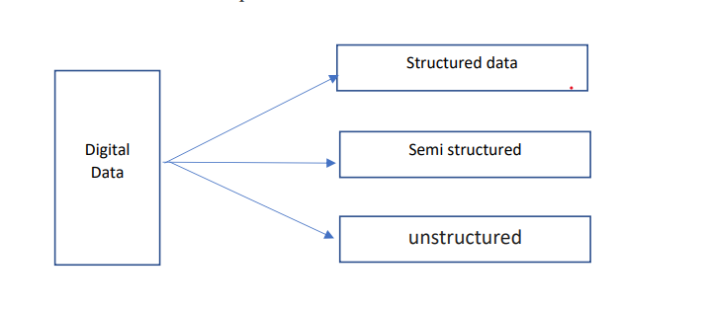

Slide 22
The 3 types of Data: Structured data, Semi-structured data, and Unstructured data.
Structured data
Structure data includes data contained in relational databases and spreadsheets or in a tabuuar schema
It has been organized into a formatted repository that is typically a database.
It concerns all data which can be stored in database SQL in a table with rows and columns.
Structured data has the advantage of being easily entered, stored, queried and analyzed.
Structured data is very significant because it enables the rapid data collection from numerous database locations.
Example: Relational data.

Slide 23
Semi-Structured data
Semi-structured data is information that does not reside in a relational database but that has some organizational properties that make it easier to analyze.
A combination of unstructured and structured data is semi-structured data.
As a result, it incorporates some characteristics of structured data, but also lacks a clear organisation and does not adhere to relational databases' or data models' official formats.
With some processes, you can store them in the relational database (it could be very hard for some kind of semi-structured data).
Due to unorganized information, the semi-structured is difficult to retrieve, analyze and store as compared to structured data.
Example: XML data, JSON, etc

Slide 24
Unstructured data
Unstructured data is data which is not organized in a predefined manner or does not have a predefined data model, thus it is not a good fit for a mainstream relational database.
Unstructured data refers to information that lacks predetermined conceptual meanings and is difficult for conventional databases or data models to comprehend or analyse.
So for Unstructured data, there are alternative platforms for storing and managing, it is increasingly prevalent in IT systems and is used by organizations in a variety of business intelligence and analytics applications.
Most large data is made up of unstructured data, including facts, dates, and numbers. Video and audio files, mobile activities, satellite photos, and other types of big data
Example: Word, PDF, Text, Media logs.

Slide 25
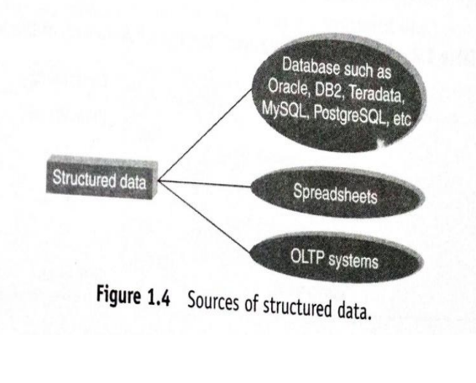
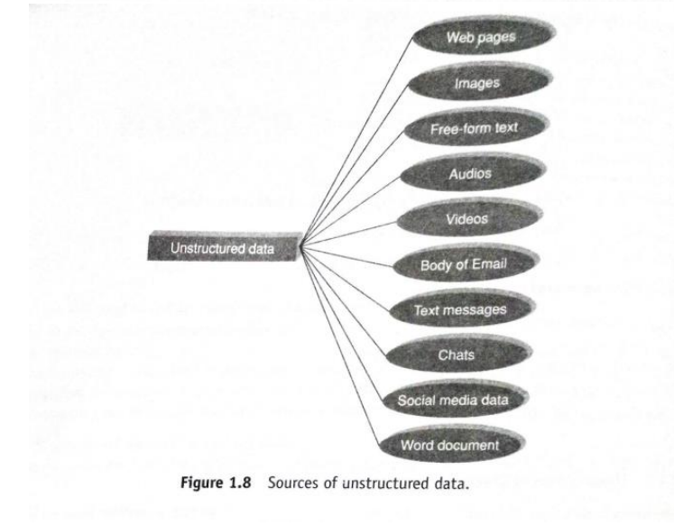
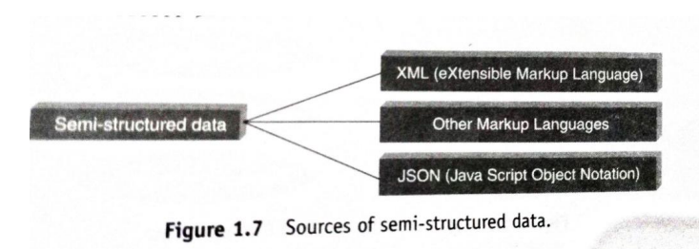

Slide 26
Properties | Structured data | Semi-structured data | Unstructured data
Technology | It is based on Relational database table | It is based on XML/RDF(Resource Description Framework). | It is based on character and binary data
Flexibility | It is schema dependent and less flexible | It is more flexible than structured data but less flexible than unstructured data | It is more flexible and there is absence of schema
Scalability | It is very difficult to scale DB schema | It’s scaling is simpler than structured data | It is more scalable.
Level of organizing | Structured Data as name suggest this type of data is well organized and hence level of organizing is highest in this type of data. | On other hand in case of Semi Structured Data the data is organized up to some extent only and rest is non organized hence the level of organizing is less than that of Structured Data and higher than that of Unstructured Data. | In last, the data is fully non organized in case of Unstructured Data and hence level of organizing is lowest in case of Unstructured Data.
Query performance | Structured query allow complex joining | Queries over anonymous nodes are possible | Only textual queries are possible
Robustness | Very robust | New technology, not very spread | —
https://www.geeksforgeeks.org/difference-between-structured-semi-structured-and-unstructured-data

Slide 27
What are the difference between Structured and Unstructured data
1) Defined Vs Undefined Data
Structured data is undoubtedly a defined type of data in a structure.
Structured data lives in columns and rows and it can be mapped into pre-defined fields.
Unstructured data does not have a predefined data format, it is a collection of many types of varied data that are stored in their native formats.
2)Quantitative Vs Qualitative Data
Structured data is generally quantitative data, it usually consists of hard numbers or things that can be counted.
Methods for analysis include classification, regression, and clustering of data.
Unstructured data is generally categorized as qualitative data, and cannot be analyzed and processed using conventional tools and methods.
Understanding qualitative data requires advanced analytics techniques like data stacking and data mining.
3) Storage In Data Lakes Vs Data Houses
Structured data is generally stored in data warehouses.
Unstructured data is stored in data lakes.
Unstructured data requires more storage space, while structured data requires less storage space.
4) Ease Of Analysis
Structured data is easy to search, both for algorithms and for humans.
Unstructured data is more difficult to search and requires processing to become understandable.
https://k21academy.com/microsoft-azure/dp-900/structured-data-vs-unstructured-data-vs-semi-structured-data

Slide 28
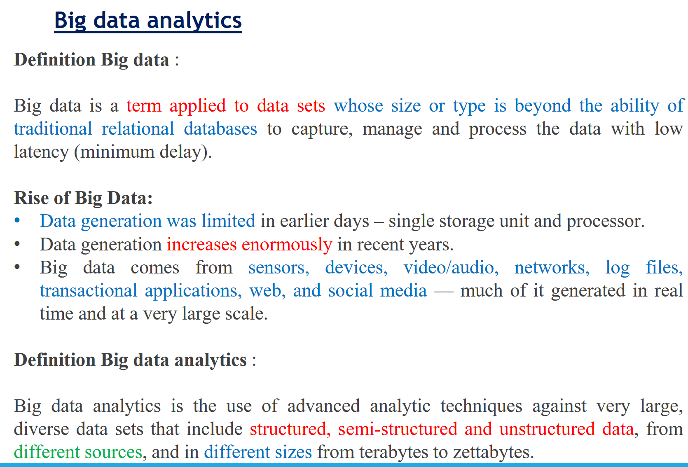

Slide 29
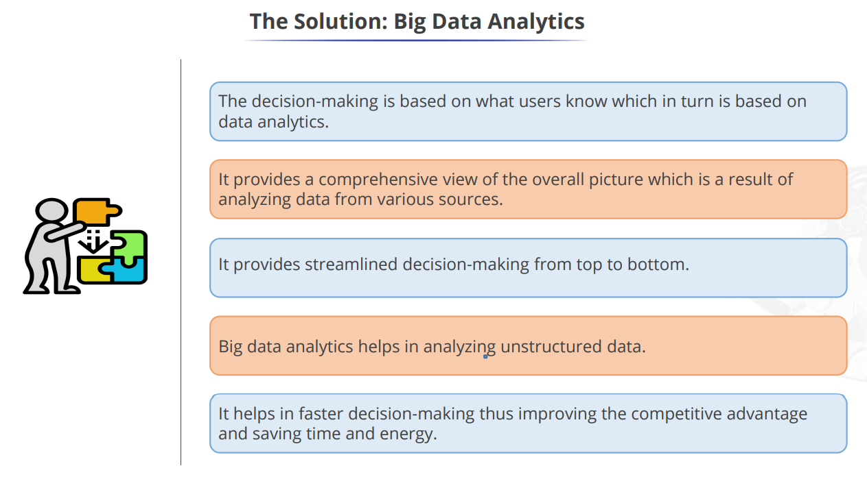

Slide 30
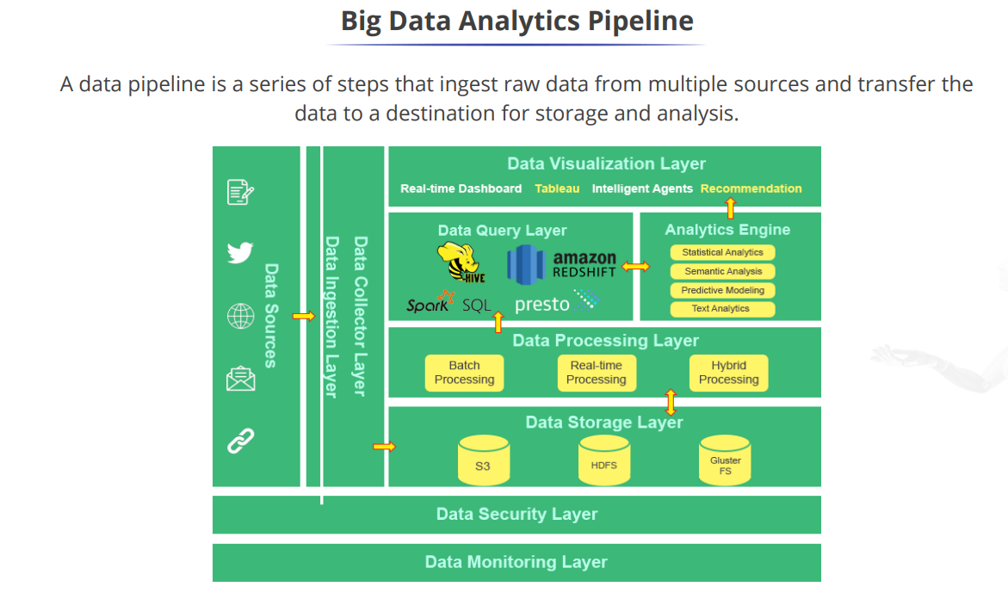

Slide 31
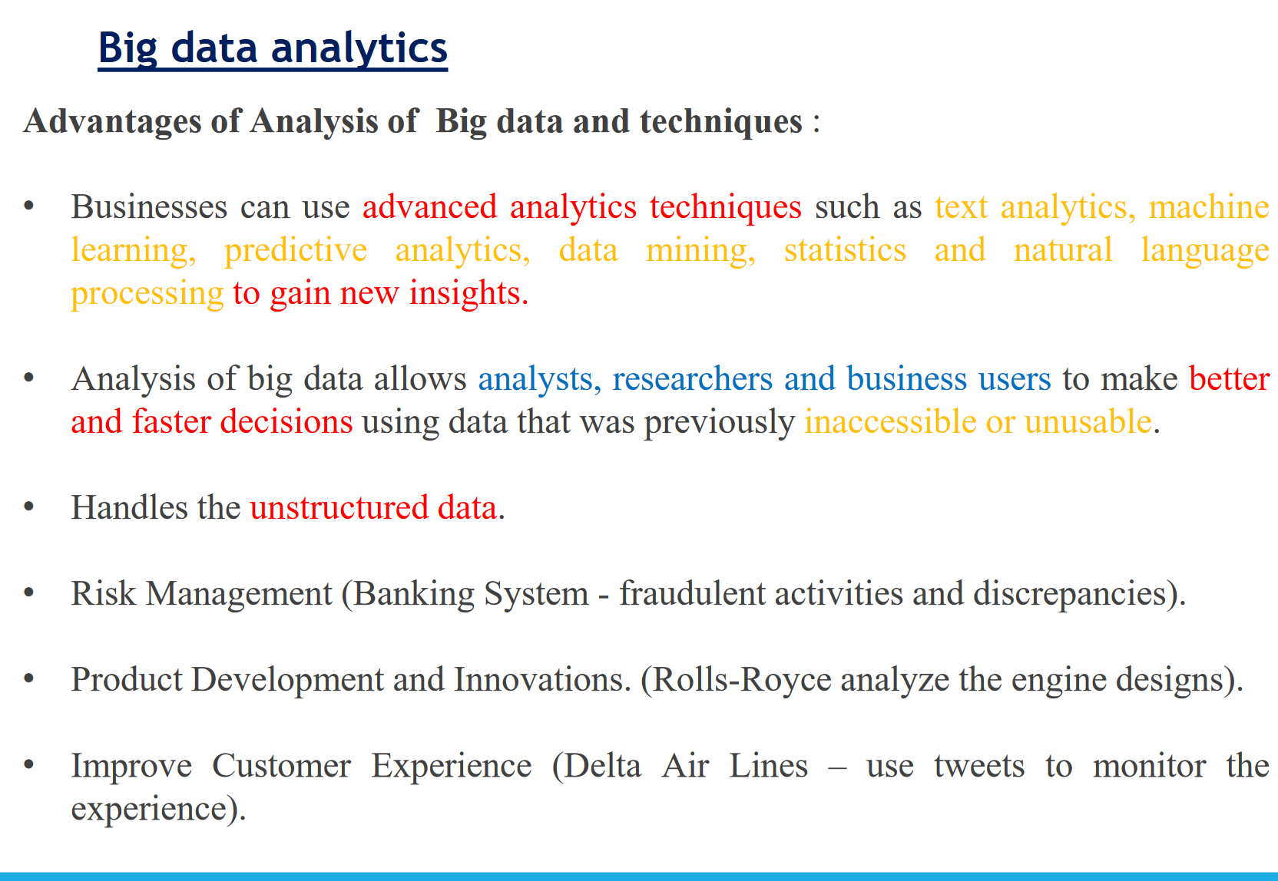

Slide 32
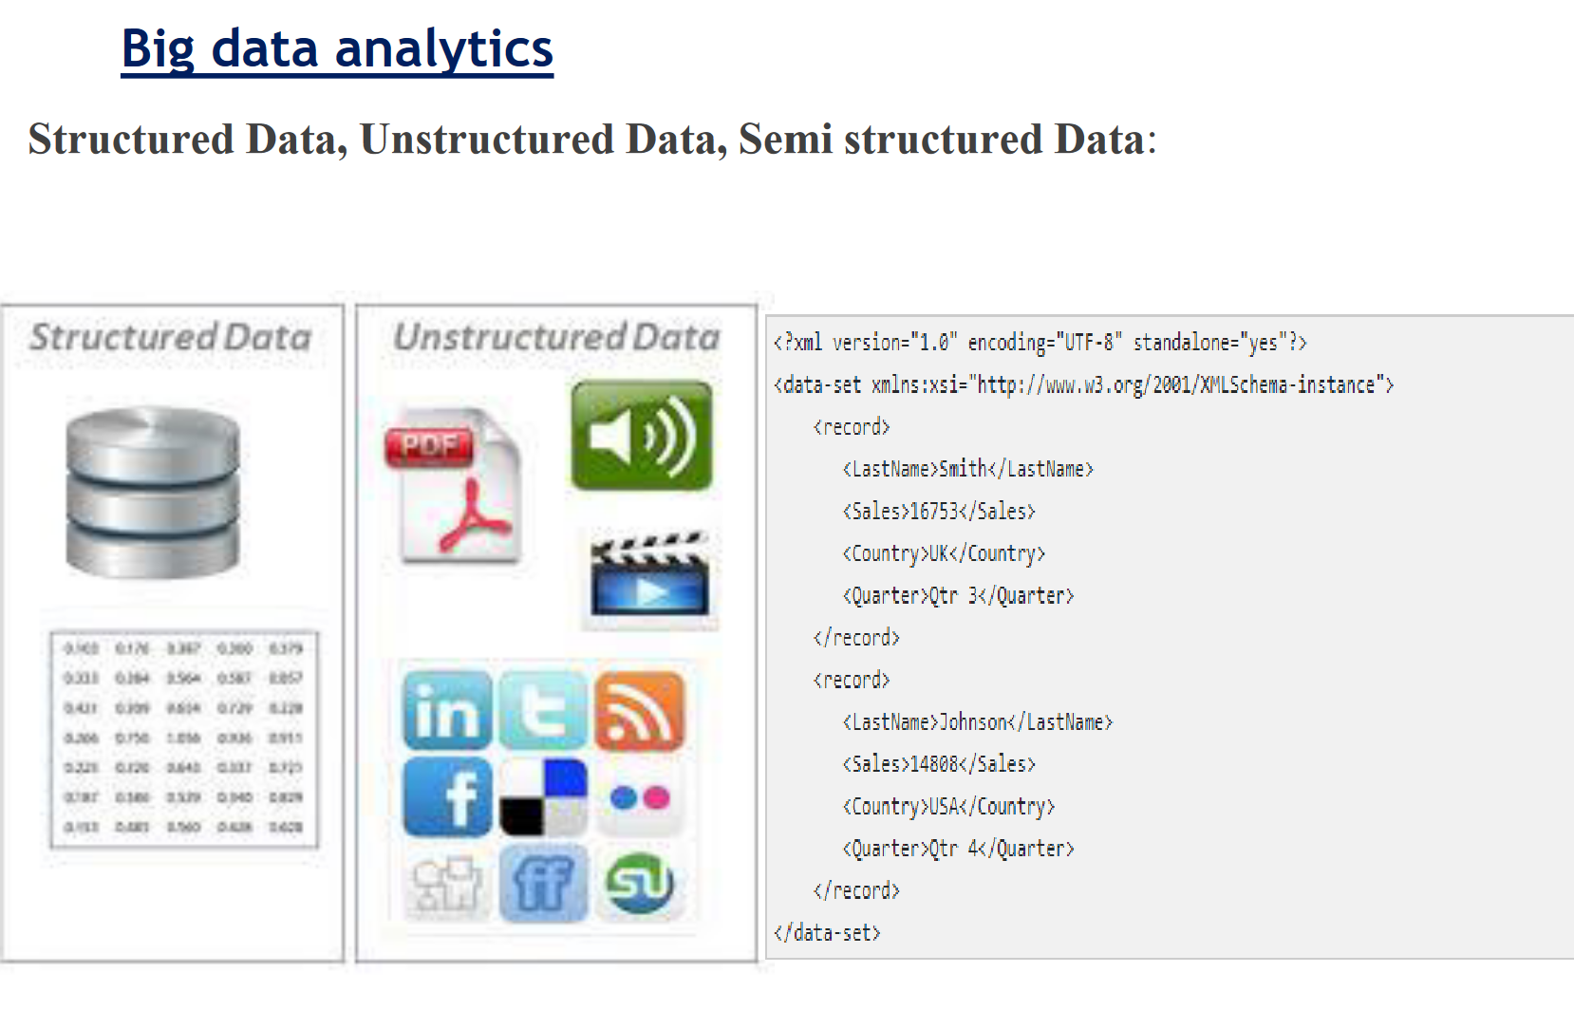

Slide 33
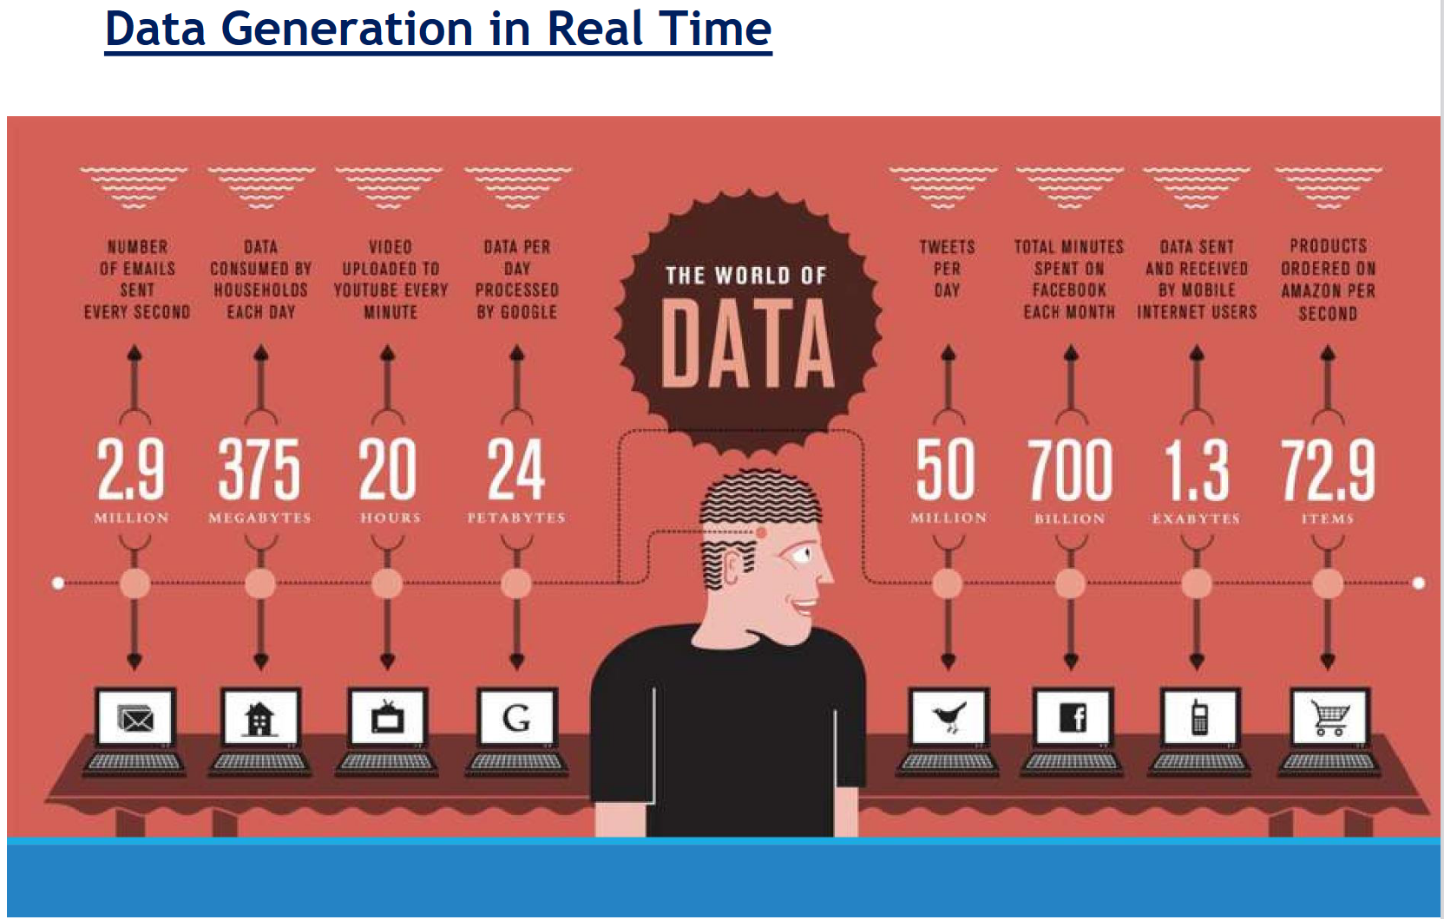

Slide 34
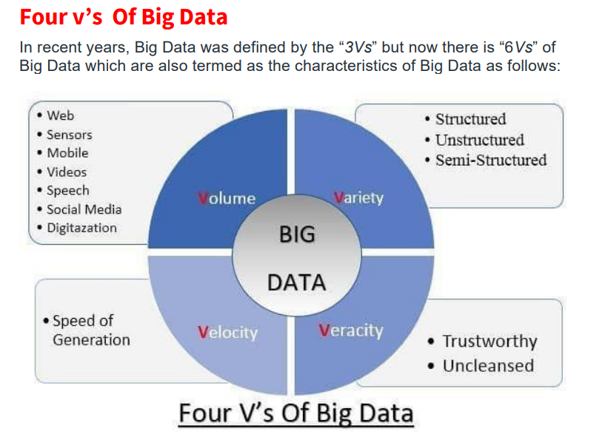

Slide 35
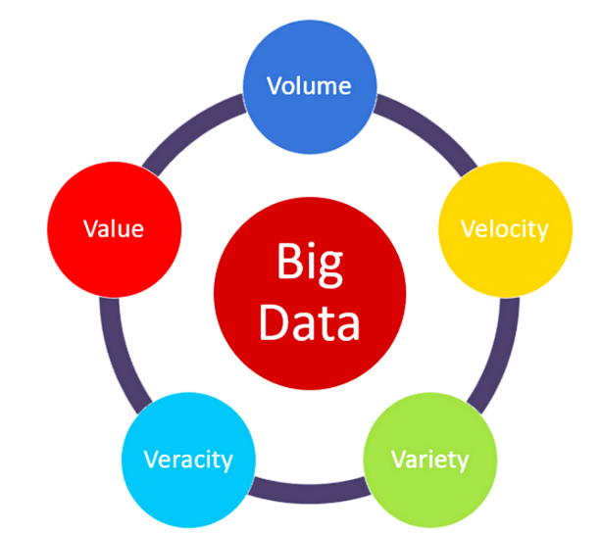
Explain 5 V's?
Volume - the amount of data
Big data volume defines the ‘amount’ of data that is produced. The value of data is also dependent on the size of the data.
Today data is generated from various sources in different formats.
Some of these data formats include word and excel documents, PDFs and reports along with media content such as images and videos.
Due to the data explosion caused by digital and social media, data is rapidly being produced in such large chunks, it has become challenging for enterprises to store and process it using conventional methods of business intelligence and analytics.
Enterprises must implement modern business intelligence tools to effectively capture, store and process such unprecedented amounts of data in real-time.

Slide 36
Velocity - ”How often new data is created and needs to be stored”
Velocity refers to the speed at which the data is generated, collected and analyzed.
Data continuously flows through multiple channels such as computer systems, networks, social media, mobile phones etc.
The flow of data will be huge and continuous in big data.
The speed at which data can be accessed has a direct impact on making timely and accurate business decisions.
Even a limited amount of data that is available in real-time yields better business results than a large volume of data that needs a long time to capture and analyze.
Variety - “How heterogeneous data types are”
While the volume and velocity of data are important factors that add value to a business, Variety refers to different formats of data that are created like structured, semi-structured and unstructured data.
While structured data is one whose format, length and volume are clearly defined, semi-structured data is one that may partially conform to a specific data format.
On the other hand, unstructured data is unorganized data and doesn’t conform with the traditional data formats.
Data generated via digital and social media (images, videos, tweets, etc.) can be classified as unstructured data.

Slide 37
Veracity – “the quality or trustworthiness of the data”
The Veracity of big data or Validity, as it is more commonly known, is the assurance of quality or credibility of the collected data.
Can you trust the data that you have collected? Is this data credible enough to glean insights from? Should we be basing our business decisions on the insights gathered from this data? All these questions and more, are answered when the veracity of the data is known.
Since big data is vast and involves so many data sources, there is the possibility that not all collected data will be of good quality or accurate in nature.
Hence, when processing big data sets, it is important that the validity of the data is checked before proceeding for processing.
It refers to the assurance of quality/integrity/credibility/accuracy of the data. Since the data is collected from multiple sources, we need to check the data for accuracy before using it for business insights.

Slide 38
Value - the significance of data or worth of the data being extracted.
Although data is being produced in large volumes today, just collecting it is of no use.
Instead, data from which business insights are garnered add ‘value’ to the company.
In the context of big data, value amounts to how worthy the data is of positively impacting a company’s business.
This is where big data analytics come into the picture. While many companies have invested in establishing data aggregation and storage infrastructure in their organizations, they fail to understand that the aggregation of data doesn’t equal value addition.
What you do with the collected data is what matters. With the help of advanced data analytics, useful insights can be derived from the collected data.
These insights, in turn, are what add value to the decision-making process.
One way to ensure that the value of big data is considerable and worth investing time and effort into, is by conducting a cost Vs benefit analysis.
The most important part of big data is to understand the costs and benefits of collecting and analyzing the data to ensure that ultimately the data can be monetized.

Slide 39
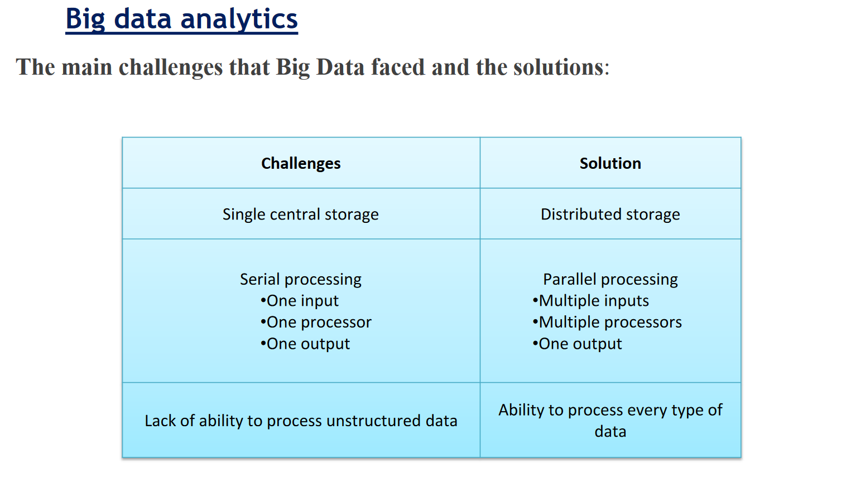

Slide 40
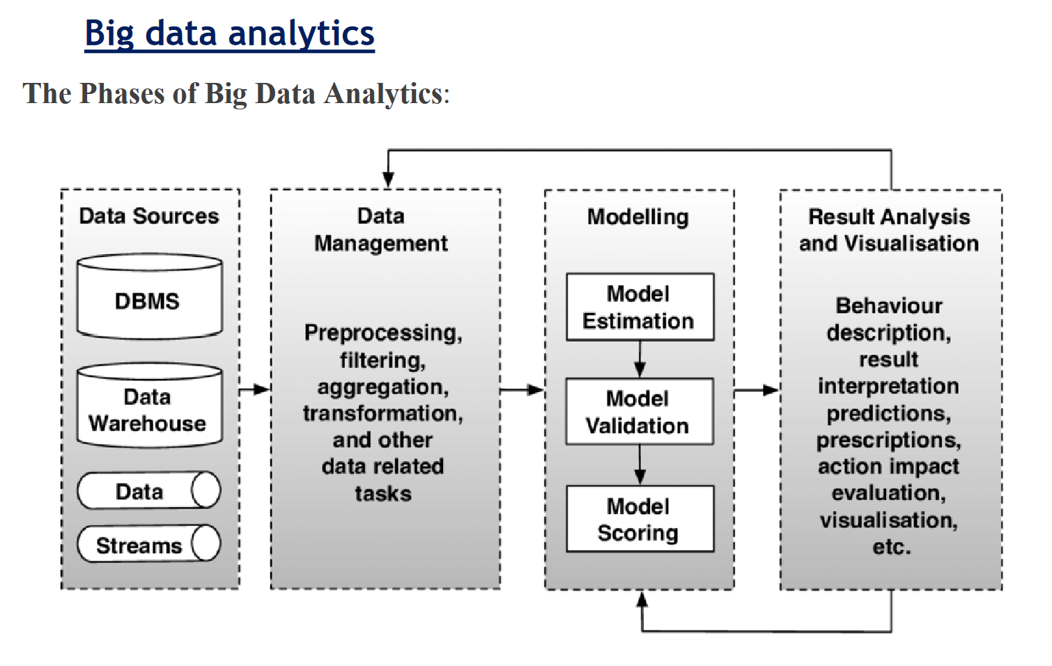

Slide 41
Drivers of Big Data
A number of business drivers are at the core of this success and explain why Big Data has quickly risen to become one of the most coveted topics in the industry. Six main business drivers can be identified:
The digitization of society;
The plummeting of technology costs;
Connectivity through cloud computing;
Increased knowledge about data science;
Social media applications;
The upcoming Internet-of-Things (IoT).

Slide 42
Drivers of Big Data
1. The digitization of society:
Big Data is largely consumer driven and consumer oriented.
Most of the data in the world is generated by consumers, who are nowadays ‘always-on’. Most people now spend 4-6 hours per day consuming and generating data through a variety of devices and (social) applications.
With every click, swipe or message, new data is created in a database somewhere around the world. Because everyone now has a smartphone in their pocket, the data creation sums to incomprehensible amounts.
Some studies estimate that 60% of data was generated within the last two years, which is a good indication of the rate with which society has digitized.
Notes:
Internet cookies are increasingly used to track user behavior and to tailor content based on this behavior.
HTTP cookies, or internet cookies, are built specifically for Internet web browsers to track, personalize, and save information about each user's session. A “session” just refers to the time you spend on a site. Cookies are created to identify you when you visit a new website.

Slide 43
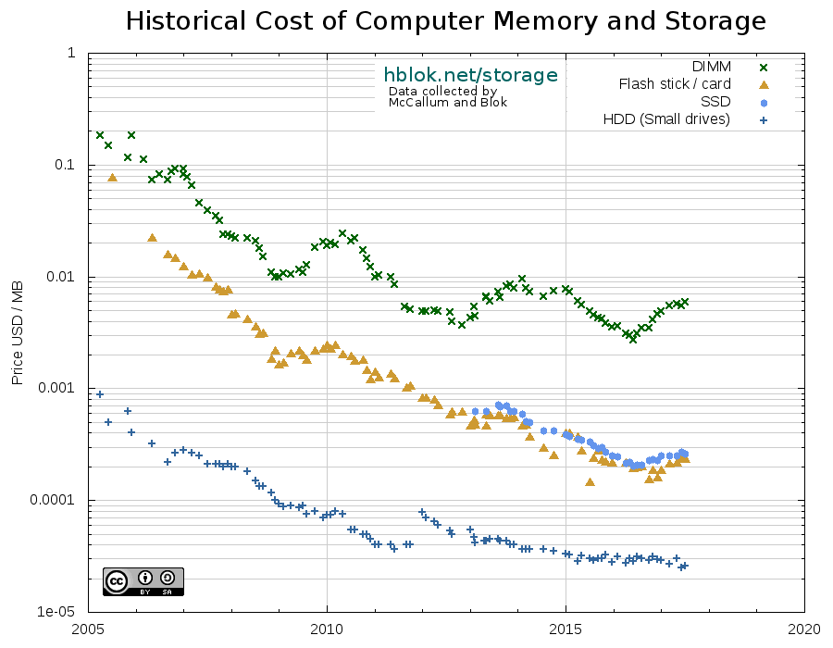
Drivers of Big Data
2. The plummeting of technology costs
Technology related to collecting and processing massive quantities of diverse (high variety) data has become increasingly more affordable. The costs of data storage and processors keep declining, making it possible for small businesses and individuals to become involved with Big Data. For storage capacity, the often-cited Moore’s Law still holds that the storage density (and therefore capacity) still doubles every two years.
Notes:
Moore's law is the observation that the number of transistors in a dense integrated circuit doubles about every two years. Moore's law is an observation and projection of a historical trend. Rather than a law of physics, it is an empirical relationship linked to gains from experience in production.

Slide 44
Drivers of Big Data
3. Connectivity through cloud computing
Cloud computing environments (where data is remotely stored in distributed storage systems) have made it possible to quickly scale up or scale down IT infrastructure and facilitate a pay-as-you-go model.
This means that organizations that want to process massive quantities of data (and thus have large storage and processing requirements) do not have to invest in large quantities of IT infrastructure.
Instead, they can license the storage and processing capacity they need and only pay for the amounts they actually used. As a result, most of Big Data solutions leverage the possibilities of cloud computing to deliver their solutions to enterprises.

Slide 45
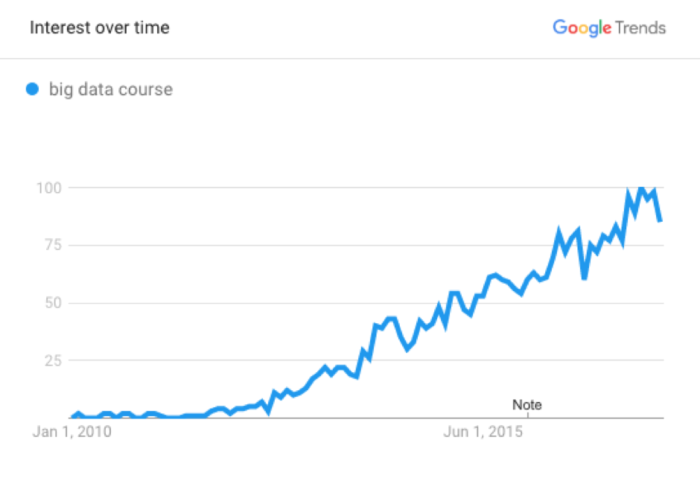
Drivers of Big Data
4. Increased knowledge about data science
In the last decade, the term data science and data scientist have become tremendously popular.
The demand for data scientist (and similar job titles) has increased tremendously and many people have actively become engaged in the domain of data science.
As a result, the knowledge and education about data science has greatly professionalized and more information becomes available every day.
While statistics and data analysis mostly remained an academic field previously, it is quickly becoming a popular subject among students and the working population.

Slide 46
Drivers of Big Data
5. Social media applications
Everyone understands the impact that social media has on daily life. However, in the study of Big Data, social media plays a role of paramount importance.
Not only because of the sheer volume of data that is produced everyday through platforms such as Twitter, Facebook, LinkedIn and Instagram, but also because social media provides nearly real-time data about human behavior.
Social media data provides insights into the behaviors, preferences and opinions of ‘the public’ on a scale that has never been known before. Due to this, it is immensely valuable to anyone who is able to derive meaning from these large quantities of data.
Social media data can be used to identify customer preferences for product development, target new customers for future purchases, or even target potential voters in elections. Social media data might even be considered one of the most important business drivers of Big Data.

Slide 47
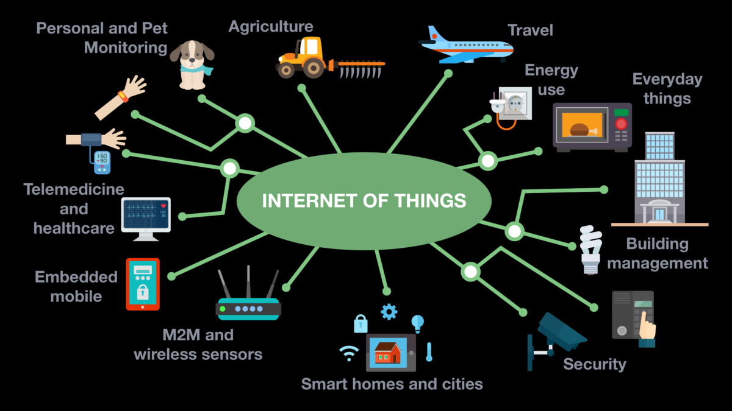
Drivers of Big Data
6. The upcoming internet of things (IoT)
The Internet of things (IoT) is the network of physical devices, vehicles, home appliances and other items embedded with electronics, software, sensors, actuators, and network connectivity which enables these objects to connect and exchange data. It is increasingly gaining popularity as consumer goods providers start including ‘smart’ sensors in household appliances. Whereas the average household in 2010 had around 10 devices that connected to the internet, this number is expected to rise to 50 per household by 2020. Examples of these devices include thermostats, smoke detectors, televisions, audio systems and even smart refrigerators.

Slide 48

